Slide 1
[Oct, 2024]
40 minutes
CS2103/T Week 8 Briefing
It does not consider ‘system crashes’
It does not contain enough UI details.
The extension given is in fact an inclusion.
No post-conditions are given.
‘Use case ends’ is duplicated.
How many of the above are problems in the given use case?
0 1 2 3 4 5
System: EZ-Link machine (those found at MRTs)
Use case: UC2 top-up EZ-Link card
Actor: EZ-Link card user
Preconditions: All hardware in working order.
MSS:
User places the card on the reader.
System displays card details and prompts for desired action.
User selects top-up.
System requests for top-up details (amount, payment option, etc.).
User enters details.
System processes cash payment (UC02) or NETS payment (UC03).
System updates the card value and indicates transaction as completed.
User removes the card.
Use case ends.
Extensions:
*a. User removed card.
*a1. System indicates the transaction has been aborted.
Use case ends.
Revisit last week’s topics using examples/questions
Preview of next week’s topics

Slide 2
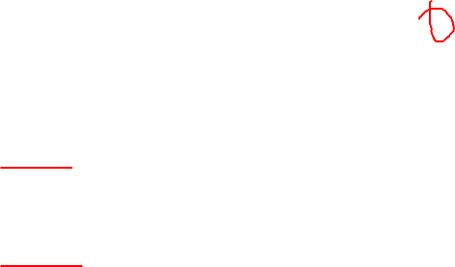
Canvas quiz for Week 8: Part 1
1
It does not consider ‘system crashes’
It does not contain enough UI details.
The extension given is in fact an inclusion.
No post-conditions are given.
‘Use case ends’ is duplicated.
How many of the above are problems in the given use case?
0 1 2 3 4 5
System: EZ-Link machine (those found at MRTs)
Use case: UC2 top-up EZ-Link card
Actor: EZ-Link card user
Preconditions: All hardware in working order.
MSS:
User places the card on the reader.
System displays card details and prompts for desired action.
User selects top-up.
System requests for top-up details (amount, payment option, etc.).
User enters details.
System processes cash payment (UC02) or NETS payment (UC03).
System updates the card value and indicates transaction as completed.
User removes the card.
Use case ends.
Extensions:
*a. User removed card.
*a1. System indicates the transaction has been aborted.
Use case ends.
Extensions: alternative diversions from the current path.
Inclusions: part of the current path, but details are elsewhere.
Notes:
Two parts in the Quiz – these are part-1
We are checking if this Usecase has any of the given problem – we go through one at a time.
a. if we were to have this in a use case. We are going to have this in every use case at every step – doesn’t make sense.
b. This is not a problem – its good thing to have – this is out.
c. Is this an inclusion or extension - It's not part of the main success scenario – so this should be extension. If you do this it wont be a success.
d. if there are no post conditions that are not worthy, we don't have to put it there - so this is not an issue as well.
e. True, we have 2 exits points and its ok to have multiple exit points.
So the answer is 0.

Slide 3
What if we …?
made a mistake in use case step numbering?
misclassified a non-functional requirement?
had an unnecessary term in the Glossary?
didn’t phrase a user story correctly?
put a UI detail in the use case?
missed an important user story?
missed an important NFR?
Some are bigger problems than others!
Requirements are rather subjective! ☹ In the exam: We’ll try to set the question to be less subjective. In real projects …
Make a judgement call, based on potential cost/risk.
Also, cross-verify with stakeholders.
Notes:
Identifying Problems in Requirements: During the tutorial, you're tasked with finding problems in written requirements. Some mistakes are minor and easy to fix, while others, like missing key user stories or NFRs, can have severe consequences for the product or product may not be useable.
Understanding Risk and Cost: The importance of the problem varies. Small issues might not significantly impact the project, but missing critical requirements can cause major issues or even make the product unusable.
Dealing with Subjectivity: In real projects, requirements can be subjective. While in exams we may avoid this, in practice, it's essential to make informed judgments and cross-verify with stakeholders to avoid incorrect assumptions.

Slide 4
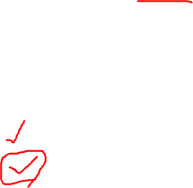
2
Question about iP: When should you save data to the disk?
Only if the user gives a command to save data
When the application is closed
After every user command
After every user command that changes data
Fewer writes.
Higher risk of data loss.
Worried about UI lag? Use threads to prevent UI lag?
More writes.
No risk of data loss.
Beware of premature optimization!
Worried about saving data even after an incorrect operation by the user? Can mitigate by providing an ‘undo’ command
[This will not affect your iP grading though]
Notes:
We are reflecting and trying to learn more from iP
We need to make Decision Based on Pros and Cons: The decision between options like saving data after user commands or on application closes involves a trade-off between fewer writes (A, B) and a higher risk of data loss, versus more writes (C, D) with reduced risk of data loss.
Priority on Data Safety: Losing data is a higher priority concern than the number of writes, so options C and D, which ensure frequent saving, are preferred. D is considered more elegant than C, but both are acceptable. Answer is C or D, but let’s choose D.
Undo Functionality: Adding an undo feature would allow users to recover from mistakes, enabling faster, more confident actions. Although not required for the iP, it’s a valuable option for enhancing usability – use it whenever possible.
Beware of Premature Optimization Warning: Introducing threads to prevent UI lag may lead to unnecessary complexity if the problem hasn’t been measured or confirmed. Premature optimization, like adding threads without clear need, should be avoided.
Don’t worry – your IP grading will not be affected – we are reflecting and trying to learn more.

Slide 5
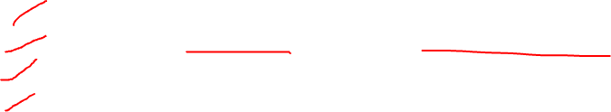
3
Changing the signature of a public method of a class can affect…
[ ] abstraction
[ ] coupling
[ ] cohesion
[ ] dependencies
class TaskList
init(List<Task> tasks) → init(File tasksFile)
Whoa! Are we going to get this kind of questions in the exam? No ‘tricky’ questions in the exam.
Notes:
By changing the init method signature, from left to right, do you think if any of these items will get affected?
Effect on Abstraction: Changing the method signature from a list of tasks to a file changes the abstraction. The class was initially abstracted as tasks in memory, but now it shifts to tasks stored in a file. So Yes, this can change.
Effect on Coupling: The method change introduces a dependency on the File class, meaning the class is now coupled with storage, whereas previously it dealt only with in-memory tasks. So in terms of code and concept, Yes, this can change.
Effect on Cohesion: How tight is the unit is? The method change impacts cohesion because the class now needs to know about both tasks in memory and where the tasks are stored, reducing the unit’s cohesion. This is same a coupling. So Yes, this can change.
Effect of Dependency: Obviously yes. Answer is ALL 4.
No Tricky Exam Questions: While this may seem tricky, this concept is important in real projects. You’ll need to think about how changes affect abstraction, coupling, cohesion, and dependencies, as they could be flagged in code reviews.
this a totally artificial thing that we are cooking up in this question.
when you're doing the real project, you'll realize that you're changing some code. You send a pull request which adds, or which changes a method in an existing class like this.
And one of the reviewers says: Hey, yeah, you're trying to change the abstraction here. This will increase the coupling. This will will lower the cohesion of this unit. So II object to this change.
This happens all the time - Just because the code works, compiles and does what it's supposed to do doesn't mean you should allow that code. Right? You have to think about these things
alright. So the answer is, all of them

Slide 6
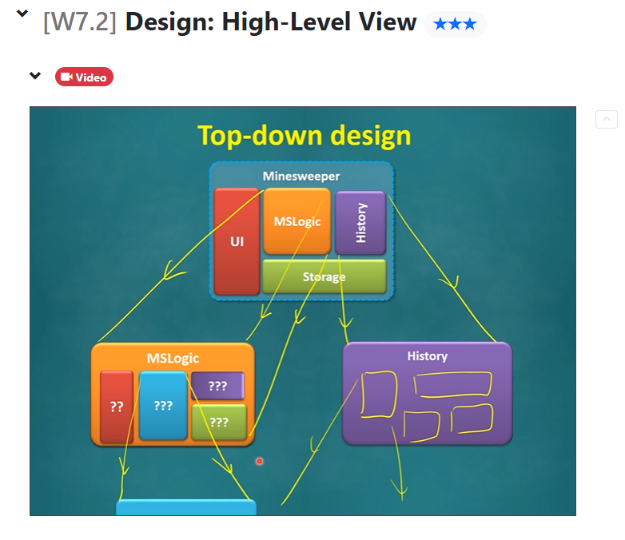
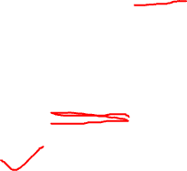
4
Question about iP: Which design approach was used?
top-down
bottom-up
sandwich
agile
(Opposite: full design upfront)
Notes:
Top-Down Design: In a top-down approach, you start with a high-level design of the system, breaking it down into components (e.g., front-end, back-end) and progressively designing each component in detail - drill it down to fine detail.
Bottom-Up Design: The opposite of top-down, bottom-up design begins by building smaller parts first, then combining them to create the overall system design.
Sandwich design: We didn’t do this because there is no such thing. Its possible to mix 1 and 2 but its not called sandwich.
Agile Design Approach: The iP project followed an agile design method, where you design and implement only what's needed for the current feature, evolving and refining the design as new features are added.
Conclusion: The iP used an agile design approach rather than a traditional top-down or bottom-up method, with iterative refinement and improvement of the design over time.
This is what I do for my FYP projects – standup meeting every week - we meet students to discuss what feature to implement next week and for that week my students try to implement it.

Slide 7
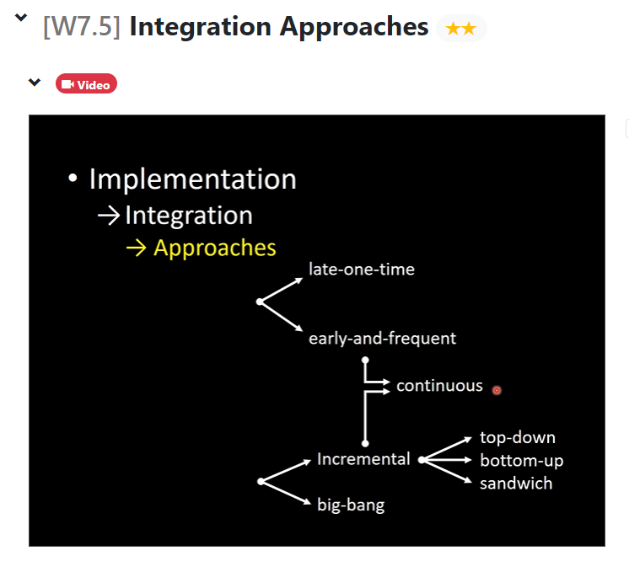

5
tP is using which integration approach?
top-down
bottom-up
sandwich
big bang
continuous
Notes:
Did we create different parts of tP and integrated using any of these approaches or did we continue to integrate whatever we are writing to the product? Sandwich is legit choice here.
Integration Approaches: There are various integration approaches like top-down, bottom-up, sandwich, big bang, and continuous integration. These define how and when different parts of the system are combined.
Continuous Integration in tP: In the team project (tP), you continuously integrated whatever code was written into the product incrementally, rather than waiting to combine everything at the end (which is big bang approach).
Right Approach: Although you may not have explicitly chosen this approach, the way the project was structured forced you to use continuous integration, which is considered the correct method for this project. The answer is Continuous approach.

Slide 8
:Timer
:Score
:MSLogic
:ScoreCard
:Score
:Minefield
:MSLogic
:Cell
:Minefield
:Cell
:Mine
:Cell
:Mine
Can you name each diagram type quickly?
Timer
ScoreCard
Score
MSLogic
Minefield
Cell
Mine
:Cell
:Cell
Notes:
In the past, we have learned these 3 types of diagram – hopefully you can name them by now?
What are they?

Slide 9
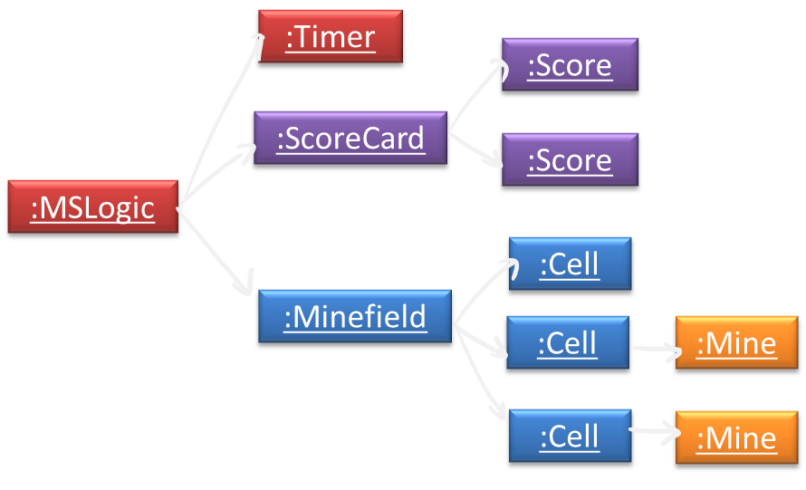
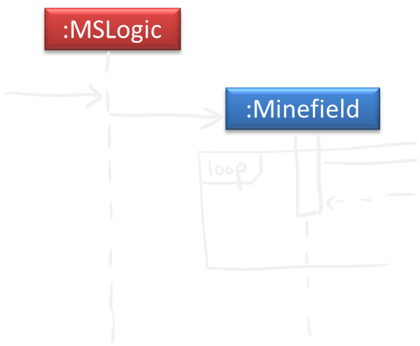
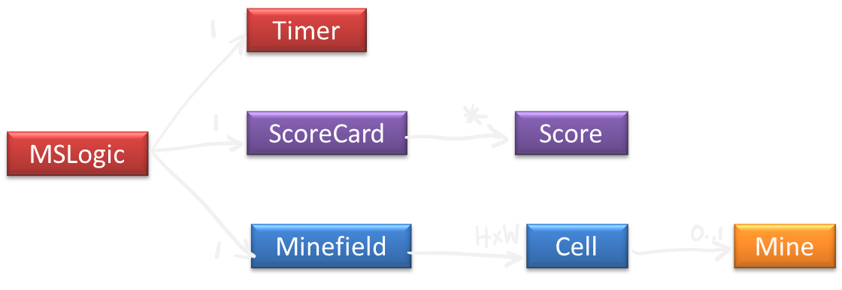
:Cell
:Cell

Slide 10
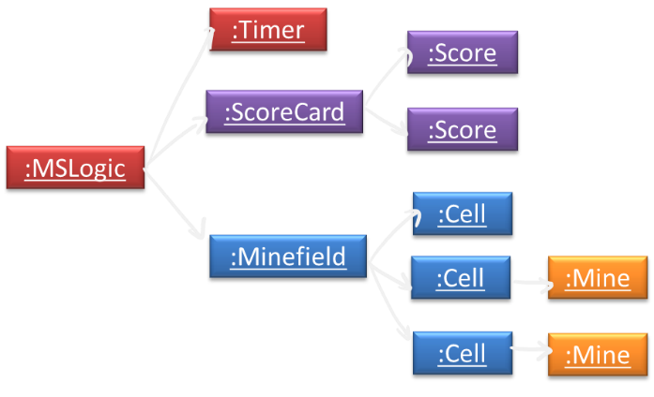
Object diagram
Sequence diagram
period
A moment
Can you remember what each diagram type represents?
Class diagram
All the time
:Cell
:Cell
Notes:
Although they all look similar, you should know how to differentiate:
Object diagram – have underline
Class diagram have never have underline
Sequence diagram has activation bar.
Object Diagram: Represents the structure of objects in a system at a specific moment in time, showing the state and relationships between objects at that snapshot.
Class Diagram: Represents the structure of classes in the system, their relationships, and how they are connected all the time as long as the system exists.
Sequence Diagram: Illustrates the interactions between objects over a period of time within a specific scenario, showing how messages are exchanged in that particular flow of operations.

Slide 11
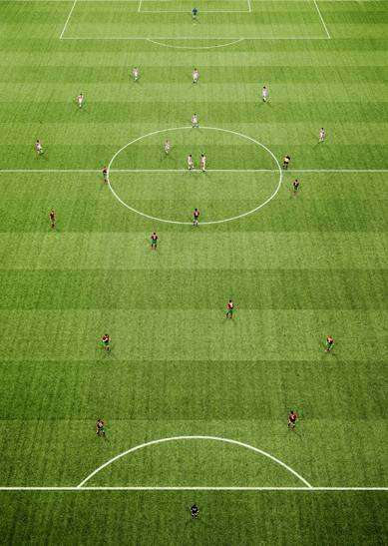
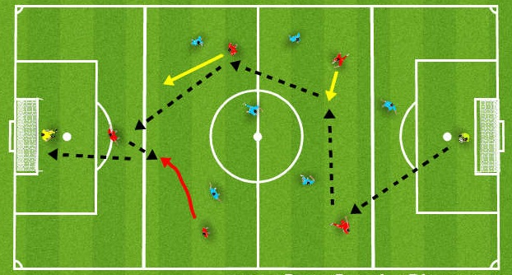
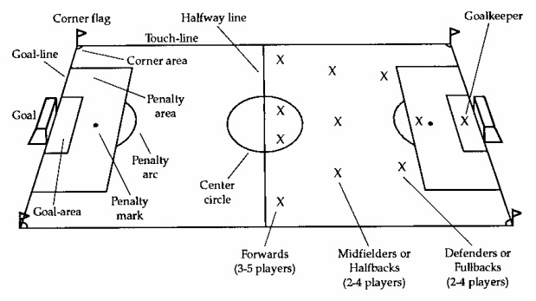
Object diagram
A moment
Sequence diagram
period
Like a strategy for scoring a goal e.g., who takes the ball first, and pass to whom next, etc.
Like a photo taken of a game which shows the current state of the game e.g., shows who is in the field, who has the ball, current scoreboard
Football analogy
Like the rules of the game e.g., how many players per side, which roles are involved, which roles can interact with which other roles, etc.
Class diagram
All the time
:Cell
:Cell
Notes:
And let me also throw in this analogy. using football to show how these 3 things are related, but also different. I'll give you a few seconds to read and think about it.
Object diagram – snapshot of the game
Class diagram – rules of the game
Seq diagram – interactions within a short duration in the game

Slide 12
Revisit last week’s topics using examples/questions
Preview of next week’s topics

Slide 13

Drawing UML diagrams
Idea →
UML
Class diagrams
Object diagrams
Sequence diagrams
…
….
→ Understand
Code →
Notes:
Earlier we started with interpreting / understanding these diagrams. Now we will focus on how to draw these diagrams.
Start with drawing diagrams for the given code, later we learn to draw without the code based on idea.
For now, let’s focus on drawing diagram for the given code.

Slide 14

Different aims, needs, tools, skills
Quick and dirty – barely enough details draw fast, talk as you draw
Neater (e.g., optimal layout, colors, …), a bit more detailed (but not a lot either).
Easy to maintain: use a tool that allows incremental edits.
Future-proof:
multiple smaller diagrams, not all-in-one
omit more volatile parts
draw at pseudo-code level (i.e., higher level of abstraction)…
Current focus
To use for,
[ ] discussion
[ ] documenting
[ ] code generation
Later in the tP
e.g., PlantUML
Idea →
UML
Class diagrams
Object diagrams
Sequence diagrams
…
….
→ Understand
Code →
Notes:
Why are we doing this? – we want to use them for discussion and documentation but not for code generation.
Here are some details, have a look, read these for few min and try to understand the reason behind it.
The difference is: First part if temporary, whereas second part is for long term.
The diagram has to evolve as people come and go over time. For now we focus on the first part, then we focus the second part later.
Answer is the first 2 choices.

Slide 15
This week’s quiz has 2 parts.
Part 1:
Covers these topics but from a interpreting/drawing perspective.
Can see the answer immediately after submitting.
Do this part before the tutorial.
Notes:
The 3 topics are exactly same as before, because these are just the notations.
The notation don't change change, but it is there as a reference. If you want to go and take a look.
Remember this time the quiz has 2 parts. The first part is to help you with these 3 topics.
same topics. But the questions are different, because questions are now focusing on the drawing aspect.
Given this code. what is the right way to draw it? and you'll get to see the answer immediately, so that this way you can not only test your knowledge, but learn from it.
Use that in the tutorial task for the coming week. Its good if you can do the part-1 of the quiz before the tutorial.

Slide 16
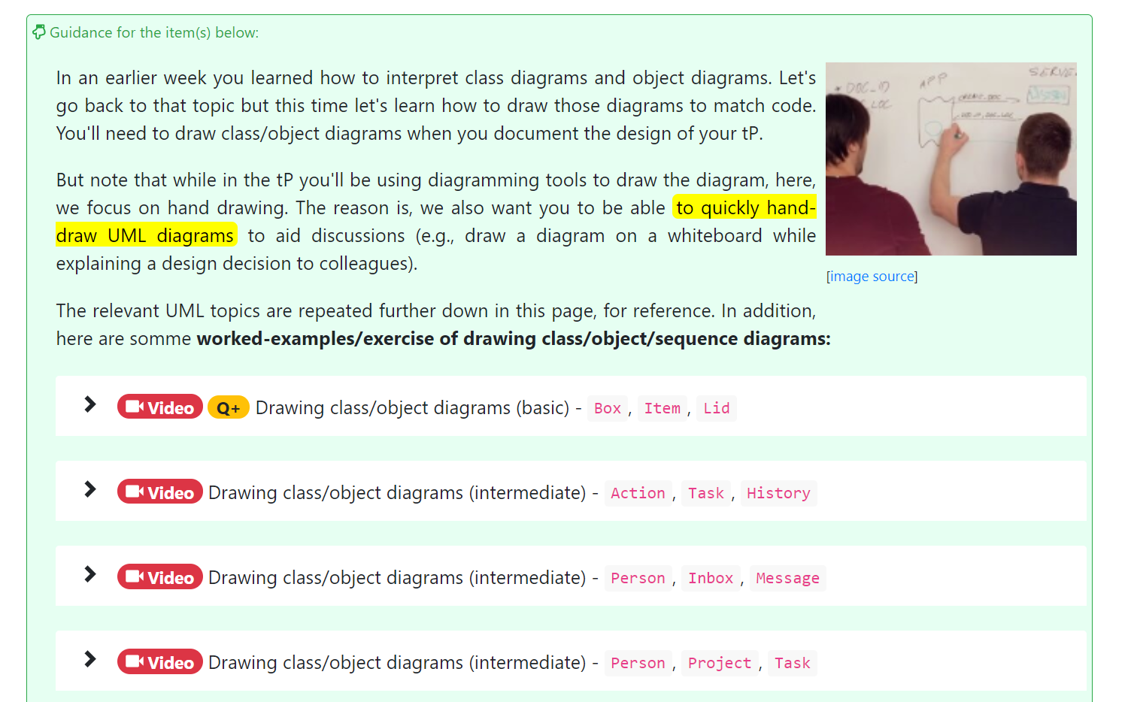
Watch some if not all (ideally, before the tutorial)
Notes:
Although the topics are same, the notations are same We have added additional stuff, these videos.
These videos shows step by step what is the process of starting from the code and drawing a diagram.
Remember, just because, you know, the notation doesn't mean you know how to draw a diagram.
It's it's a step-by-step process, right. So watching, at least some of them will help you to see at least how it can be done.
You can do this before the tutorial and then you go to the tutorial page.

Slide 17
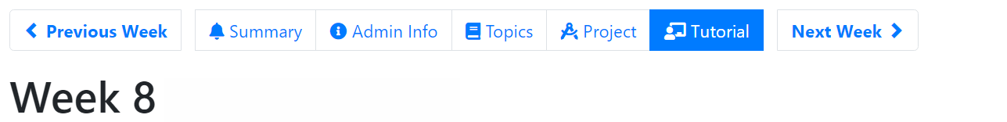
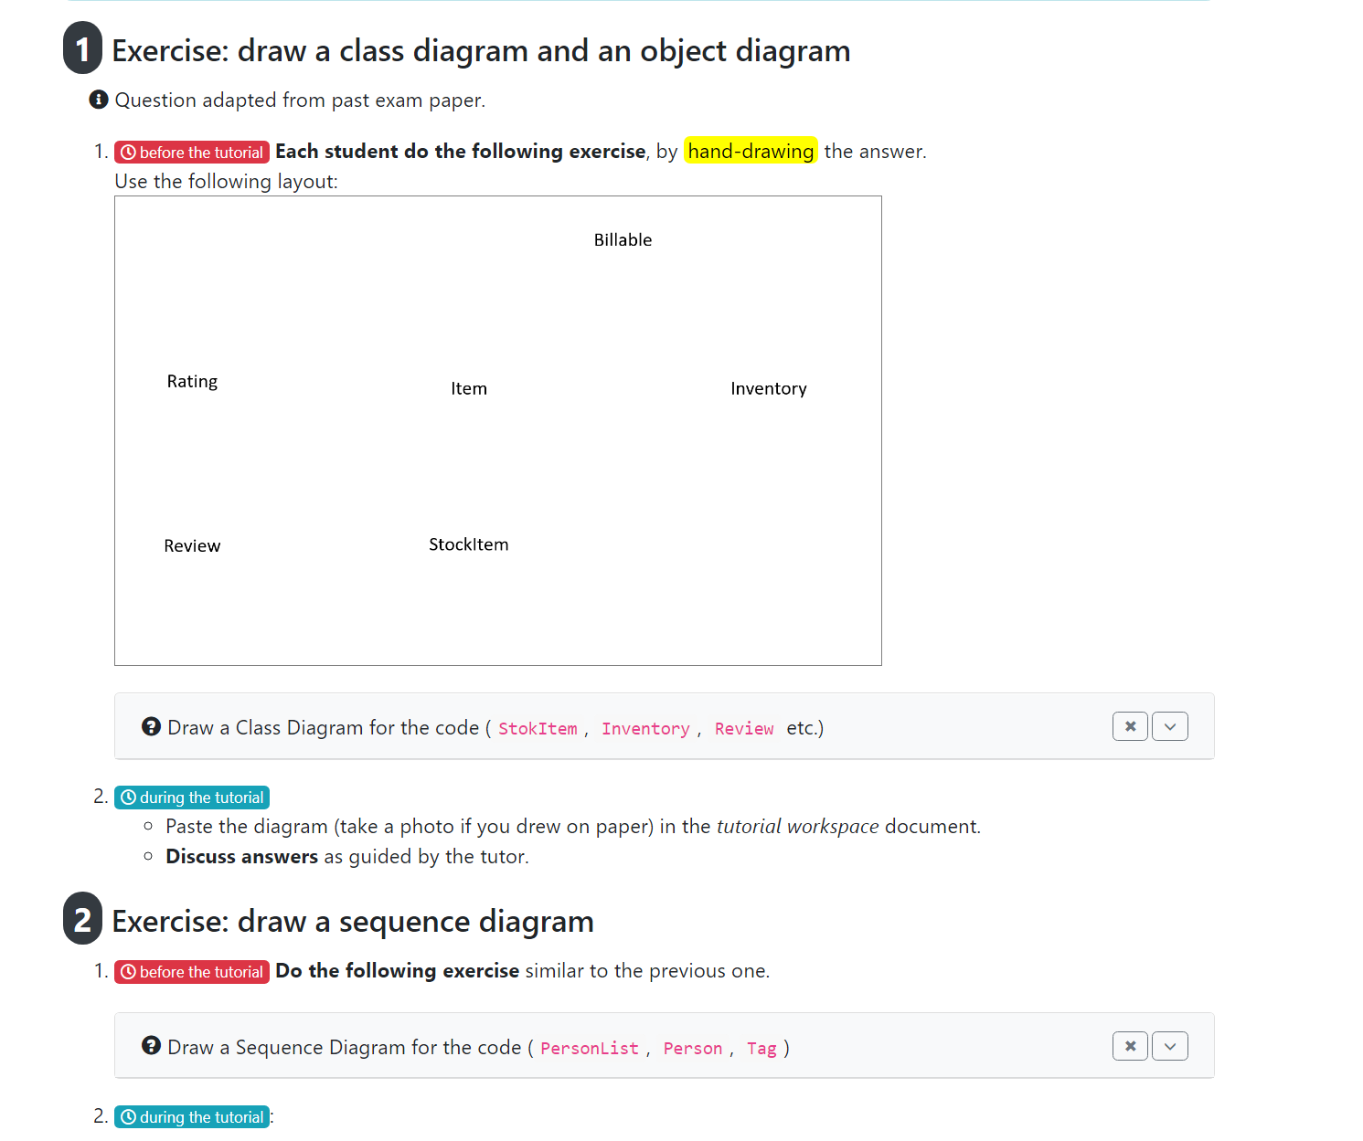
Notes:
There are 2 exercises, each one the first one. Look at the code, and then draw the diagram.
First one is to draw the class /object diagram and second one is to draw the sequence diagram.
Okay, hopefully, you can do this before the tutorial, because in the tutorial, we'll go through the answers
alright.

Slide 18
Has 2 parts. Do part 1 before the tutoral
Notes:
Do part-1 quiz before the tutorial – it will b useful for you.
Another admin thing - the midterm peer evaluation is coming. This is for the team project is coming up because you'll be finishing your first iteration.
On the IP side. We are also now moving on to evaluations. Okay, so you'll be evaluating 2 peer iPs. And hopefully, you'll learn from that as well. So that’s on the IP side.

Slide 19

Your tP, at the end of the semester …
Notes:
By the end of the semester, you’ll have a small application ready to release to the world.

Slide 20

Notes:
You hope to release it to the world, entire world. Anybody can download and use it

Slide 21

The ability to write code that can survive the harsh realities of the real world is a very important outcome of this module.
Notes:
and this world is not a very friendly place. Users out there will use it. misuse it, abuse it, try to break it, and do all sorts of nasty things, you know, they can put you in trapdoors, whatever, there can be any number of nasty things that they can try to do to your product. And the product has to survive.
It's not enough that it looks nice. It seem to work, etc. It has to survive alright. However, users may misuse, abuse, or try to break it.
So that's one of the more important learning outcomes. We focus on that a lot.
The key learning outcome is ensuring your application can survive these challenges, not just look or function well.

Slide 22
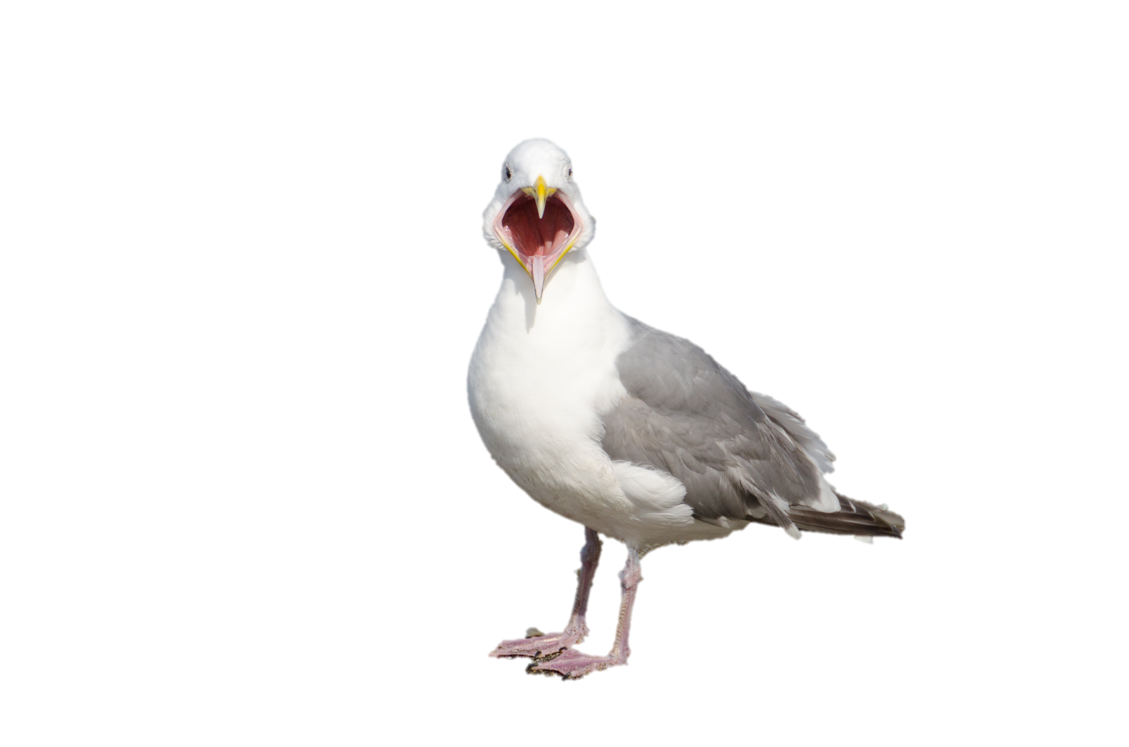


Practical Exam: 4-5 peers testing your app
Dry Run
Better to find bugs yourself!
v1.1
v1.2
v1.3
v1.4
v1.5
v1.6
Notes:
Of course, you have a bunch of a few tries to get there. You are somewhere around end of v1.1.
so you have 2 more iterations to get there. and at the end something equally nasty is going to happen, which is the practical exam. A bunch of guys will again try to break
and try to do all sorts of nasty things to your product just to see where they can survive.
Well, to help you on this, we have this dry run where you get to help each other. Prepare for this to find those bugs & problems and fix them. But we shouldn't rely too much on that.
It's much better we can, if we can, do it yourself
And one way to do that is this testing. We need to talk more about testing. We start this week.

Slide 23
Notes:
talking about testing.
Perhaps you have heard of this famous or infamous story about.

Slide 24

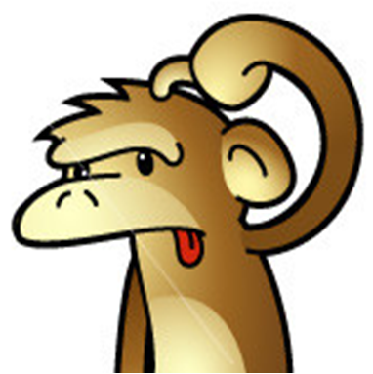
Famous Software Project Failures – Denver Airport Project
Project goal: automate the handling of baggage through the entire airport.
Extensive tests done, even using real baggage belts.
But critical operations failed entirely when they switched to the new system.
How come the bugs were not found earlier during testing?
But it worked in my machine!
Reason: The testing was done using empty bags. The sensor output was slightly different when actual bags were on baggage belts, which caused the system to malfunction.
Notes:
yeah, there's a bunch of software disasters that people talk about a lot. This is one of them. I'll give you a few seconds to read this.
Alright. So this is what happened. This was a huge deal long ago, but this was a huge deal, because, you know, shutting down an airport like one and a half days is is.
is no joke - The cost was enormous, and they even set up a commission - Government-level Commission to find out what happened, and one of the things they found was that after so much extensive's testing, they still couldn't find the problem that actually caused the crash. Because of this.
So this very specific condition was triggered only when the bags were heavy. but during testing they were using empty bags.
They would have thought, What does it matter if empty bags are used. How does it affect the software? It affected the SW, somehow. And this particular condition was never triggered during testing. They did not have a chance to troubleshoot and fix it.
It only happened during production during live run.
Testing in development and testing environments isn't enough if the application fails in production. The common excuse, "It works on my machine," doesn't justify the failure. It's crucial that the application works in the production environment, which is why different types of testing are necessary to ensure this. That’s why we have this topic in this week.

Slide 25
Unit testing
Integration testing
System testing
Acceptance testing
Alpha/beta testing
Exploratory vs scripted testing
Notes:
And this is why we need different types of testing focusing on different things.
So far, you have learned about unit testing this week, you'll learn about these other types of testing. The last one is not a type of testing. Rather it is a
2 different ways of coming up with test cases which can be used in any of these testing.

Slide 26
Foo
(SUT)
Bar
How can I test Foo without being affected by Bar?
→ Dependency Injection
Can we make Foo easier to test?
→ Testability
To what extent Foo is being tested?
→ Test coverage
Notes:
Dependency Injection: When testing a component like "Foo" that depends on "Bar", bugs in "Bar" can affect your tests. Using dependency injection helps isolate "Foo" from "Bar" during testing. This week you learn this topic.
Testability: It’s important to make components easier to test. Improving testability reduces the effort required for effective testing.
Test Coverage: You need to measure how much of the system is being tested, which is where test coverage comes in to ensure you’re testing enough of the system.

Slide 27
Dependency injection
Testability
Test coverage
Notes:
These 3 topics are covered in the coming week.

Slide 28
Notes:
In the Tp, you will start milestones. Basically, you start the first milestone that
or the first iteration that will change the product itself.
1.1 was just documentation, right. That was just practice.
This is the real deal.

Slide 29

More learning, less dependent on others
tP work division:
[ ] Recommended to divide by feature
[ ] Recommended to divide components (UI, Logic, Storage, etc.) among members
More expertise within the team
Notes:
How do you divide the work?
Divide by Feature: Dividing work by feature ensures more learning opportunities, as each member works on both front-end and back-end components, making them less dependent on others. You don’t need to wait for others to implement this particular storage mechanism because your module need it.
Divide by Component: Dividing work by component (UI, logic, storage) allows team members to develop deeper expertise within a specific area, but it increases dependency on others to complete features. Here you will work on less amount of code, but with deeper expertise – rather than everyone knowing little, it’s good to have each one knowing deeper understanding on some items.
Both has it’s own benefits.
Recommended Approach: The course recommends primarily dividing work by feature for more learning and independence, but each member should also take charge of a component to gain in-depth knowledge of that part. i.e., primarily you will divide by features, But also you should be in charge of at least one component.
The answer is both of them.

Slide 30

debugging features
code navigation features
A sample of Intellij code editing shortcuts
What if not using Intellij? Observe, and look for similar features in your code editor.
Notes:
IntelliJ Code Editing Shortcuts: We are introducing IntelliJ shortcuts to enhance your coding experience, especially for larger projects like the TP.
For Non-IntelliJ Users: Even if you're not using IntelliJ, observe these features and find similar shortcuts in your preferred code editor to improve your efficiency.
Check Your Tools: If you cannot find these features in your current tool, reconsider if it's the best choice unless you're confident you can work efficiently without them.

Slide 31
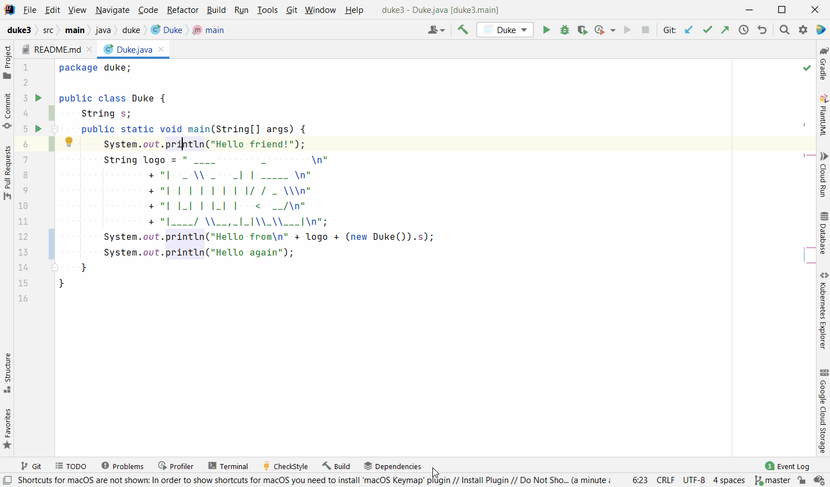
Insert a new line below current line
Normal way:
Go to end of current line
Press enter

Slide 32
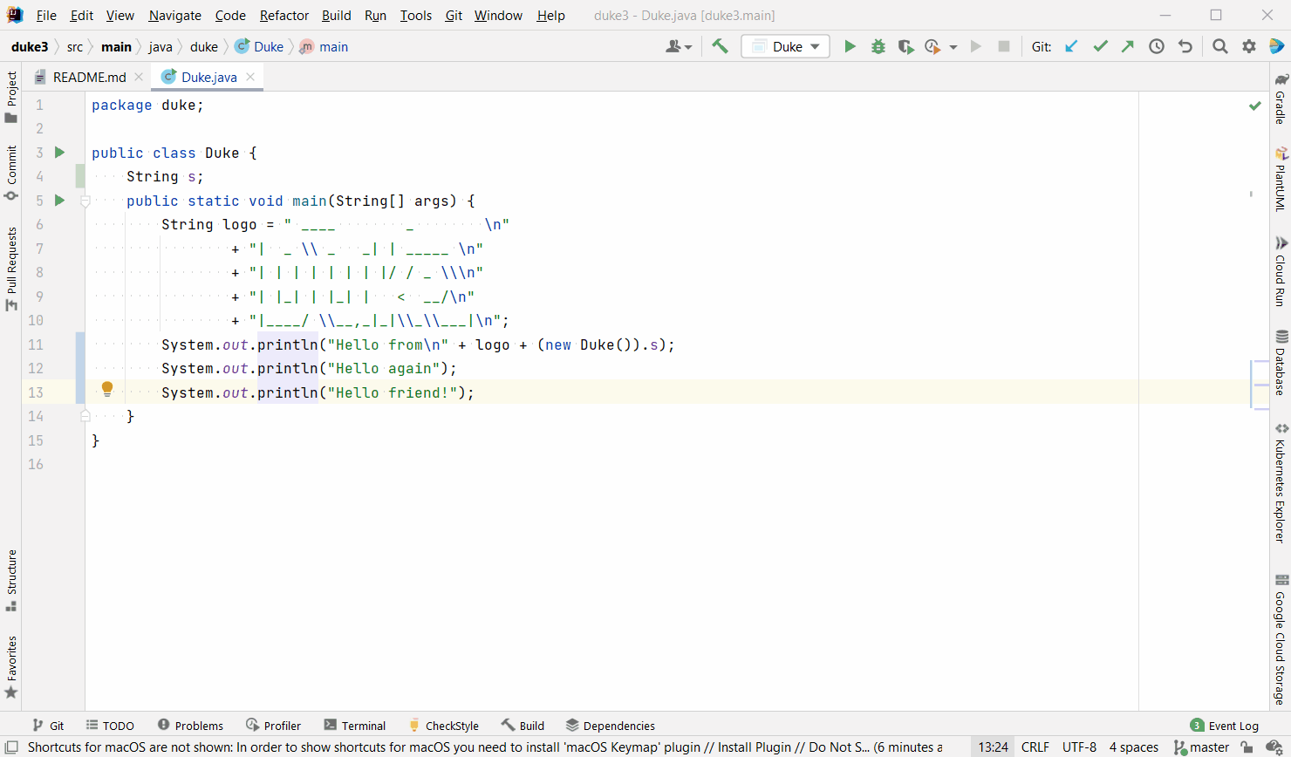
Move a line up/down
Normal way:
Select line
Cut
Go to new location
Create blank space
Paste

Slide 33
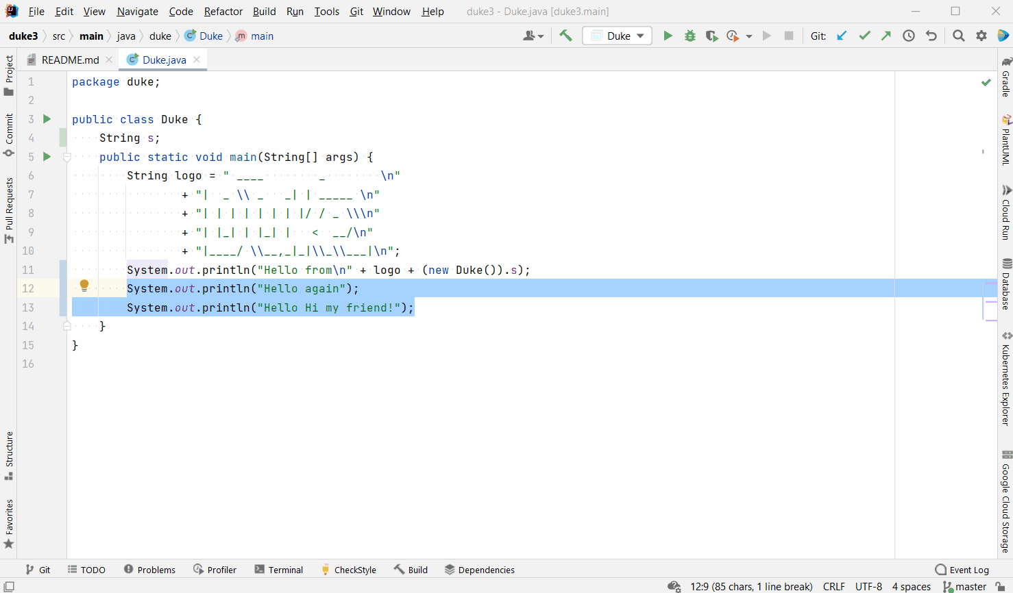
Move a block up/down
Normal way:
Select block
Cut
Go to new location
Create blank space
Paste

Slide 34
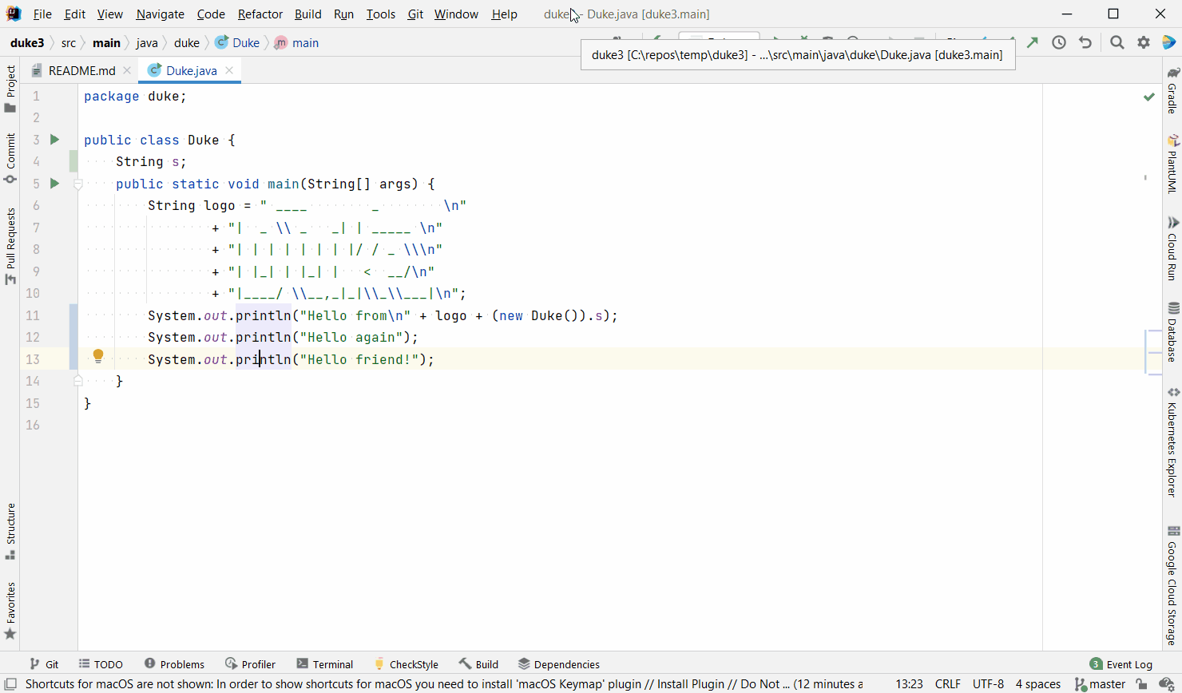
Duplicate line
Delete line
Cut/copy line
Normal way:
Select line
Perform operation
Notes:
Duplicate – Ctrl+Y
Delete – Ctrl+D

Slide 35
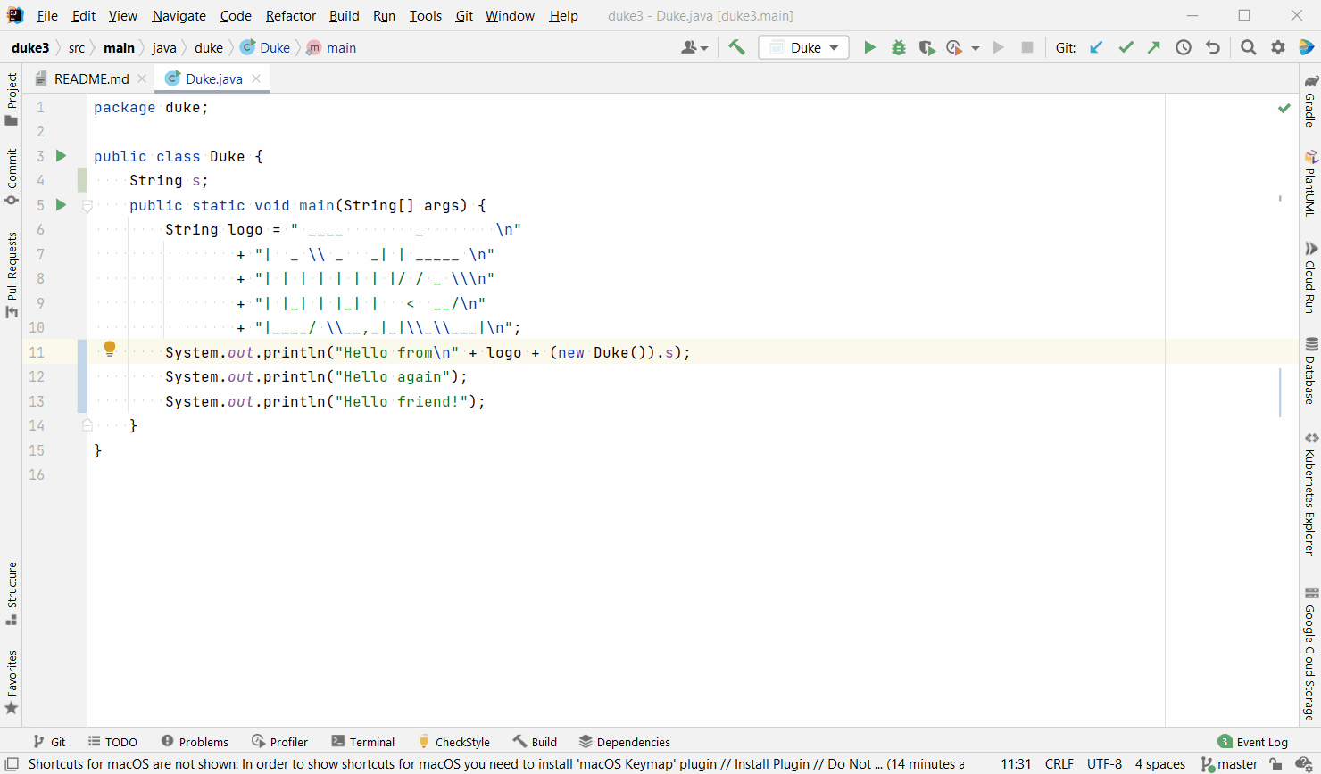
Extend selection progressively
Normal way:
Put cursor at start location
Drag cursor to end location
Notes:
Progressively expands the selection when you keep pressing the Ctrl+W
First just a word, Then the entire string, entire formula, entire statement, progressively expands to code block,, method, class, and so on.
You stop whenever you want to, and then you have the selection.

Slide 36
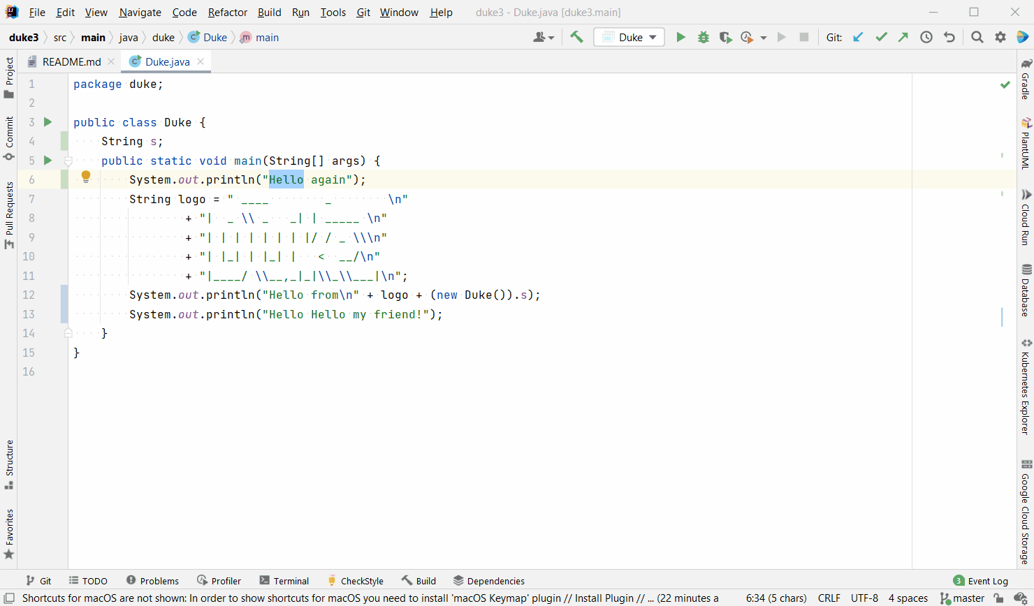
Select same text incrementally
Multi-cursor editing
Normal way: Find and replace
Notes:
You select the first occurrence, and you want to select the others, alt+J, Alt+J until you are happy that you have selected all the ones you wanted.
This is much better than find and replace. You feel more in control. You can see what's happening at the same time. And it's it's faster also.

Slide 37
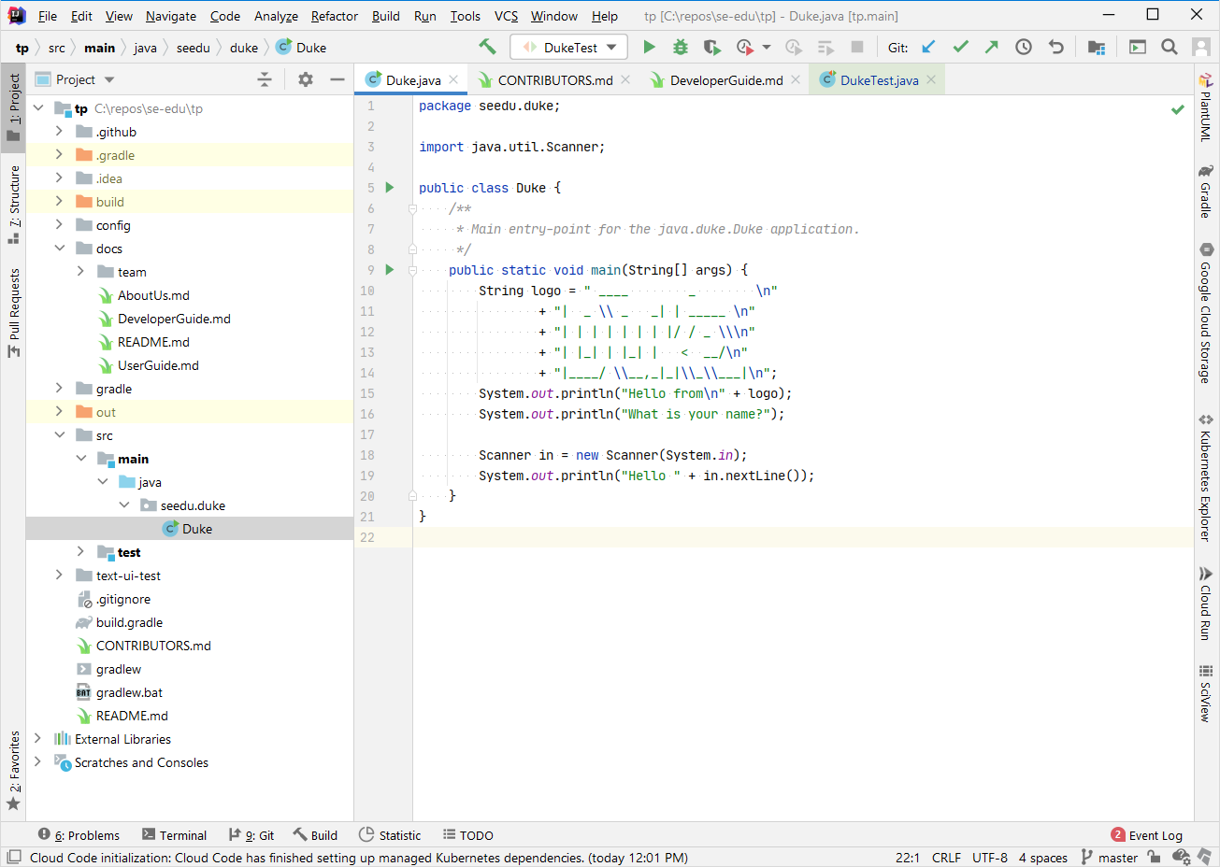
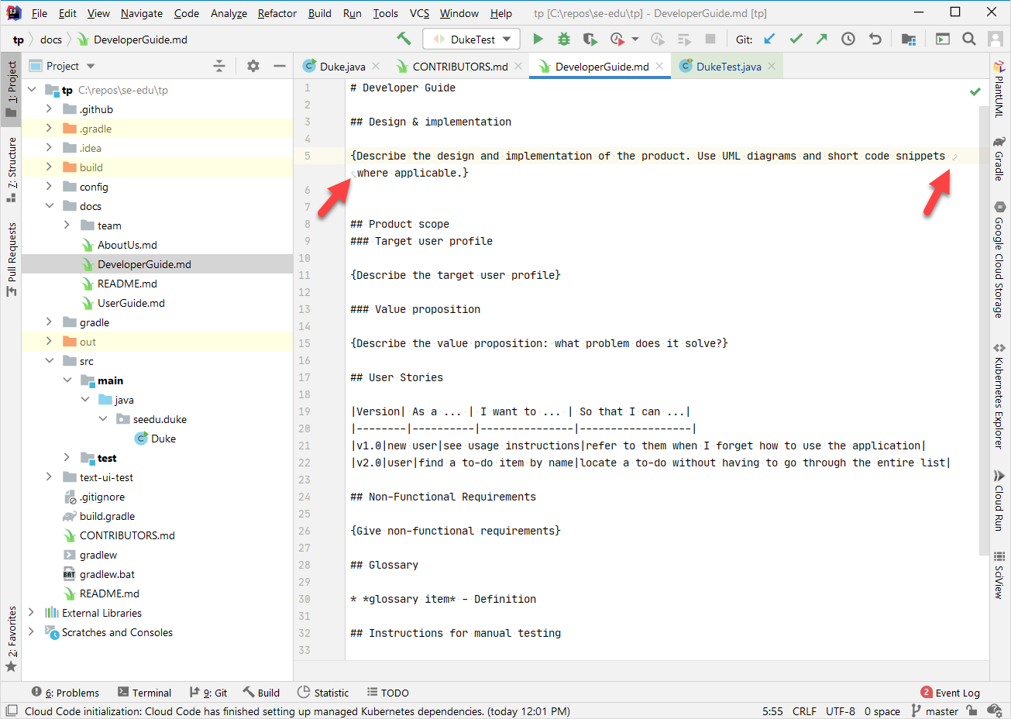
Insert line below/above, move line, delete line, incremental select, select similar, multi-cursor edits → Just a sample only; there are many more …
To avoid horizontal scrolling ….
enable soft-wrapping long lines
Notes:
What you have seen is just a sample, there are many things you can do.
Horizontal scrolling - horrible thing – if you need to do horizontal scrolling to read whatever, that’s horrible.
With Java, you don't have to do that. If you follow the cording standard because there's a maximum length for a statement.
if longer, you put it in the next line. In fact, that is the reason why we do that
to avoid horizontal scrolling.
But for other things like Markdown files, HTML files, Json files, and so on.
That's not the case.
In fact, you should not put such such line breaks in in those files
instead. you can enable this thing called soft wrapping.
When you do that. If a line is longer than what you can see in the in the window.
The ide automatically shows the rest of the line below it. It's the same line. It's one line, but you can see the whole thing there. You don't have to scroll horizontally.
This is a lifesaver. When you're editing Markdown files you'll you'll realize that if you enable this, then it is much better than the other one.
It is not enabled by default, you have to enable it.
You have to manually enable it.

Slide 38
Revisit last week’s topics using examples/questions
Preview of next week’s topics
Some general advice
No direct relation to grading!

Slide 39
So much gunk!
quality control
managing morale
teamwork
communication
workflow
knowledge transfer
estimating
evaluating
debugging
meetings
testing
scheduling &
tracking
documentation
coding
tooling
staffing
training
design
dev ops
office politics
dealing with users
dealing with customers
dealing with managers
Can avoid?
Notes:
As you start learning programming. it feels that coding is the is the main thing. You know. It's the hardest thing. It's a thing you're learning.
It seems to take all the energy and effort and everything right.
But already you must realize that, that's not the main thing or the only thing. There are so many other things around it that take more time and effort.
You'll encounter this more and more as you progress to the tP or on to real projects.
There's a lot more.
And these are the okay stuff. There are stuff that are more painful like this.
So much extra gunk that you have to spend time on like 90% of the time.
Coding is much, much small component compared all the rest. So even if you like coding, if you're good at it. your success still depends on how well you can deal with all the rest of these things.
Can we avoid them? Some of them, some of the time. But not everything all the time. Even if you have your own company, your own product, it'll be worse - because you have to do all of this yourself.
So we cannot avoid all of them all the time.

Slide 40

So, what can we do? Learn to do them.
Knowing what to do is easy!
E.g., Use buffers to reduce deadline risks, use an issue tracker to keep track of tasks
But no out-of-the-box solutions; and your mileage vary.
Using, but no gains Pain in the a**, tedious
To get here, you need to try sincerely, with the right aims.
You are here.
Image credit: https://publicdomainvectors.org/en/free-clipart/Vector-image-of-tired-stick-man-figure/18858.html
Notes:
This is the best we can do - learn to deal with them with less effort, so that they are less painful, and so on, and so forth.
Knowing what to do. It is easy.
Deadline risk is a major problem. – but use buffers. You understand it. You can learn this in in 5 min. 1 min is enough. You already know this. But does this mean after this point, you will never encounter deadline issue?
No. because of this - there are so many other factors involved. And there's no one thing that you can do to entirely avoid those problems and get Success every time. No such thing.
And when you're learning these new things, especially tools, processes, techniques, workflows, things like that. There is also a period of time. It makes things worse. It makes things slower, more painful than before.
The learning curve - where there's no gain but there's pain during this period.
Most of the time you are here, whether it is github forking, workflow, etc., You are in this area. It's slow. It's painful. Eventually, hopefully, you'll get here so that it it starts paying off. But this could take time even
at the end of the semester.
You could still be somewhere here, right if you continue at it sincerely, genuinely not because you want this thing to be green in the dashboard, or because you, you fake it because the course expected it. If you really trying to learn it so that it makes your life easier later on. Then eventually we'll get here.
and I hope you'll you'll do that alright.
Anything you do first time – it is difficult right?

